Slide 1


Santosh Kumar Kar,
skkar.2k2@gmail.com

Slide 2
CHAPTER – 8
EntityManager
Santosh Kumar Kar
skkar.2k2@gmail.com

Slide 3
EntityManager
Is a part of the Java Persistence API.
Follows the JPA 2.0 specification.
Common annotations:
@Entity
@Id & @EmbeddedId
@MappedSuperclass
@PersistenceContext with EntityManager
@Transactional

Slide 4
Dependencies
spring-context
spring-orm
hibernate-core

Slide 5
persistence.xml
When the entity manager is created, it will search persistence.xml from the class path META-INF/ folder.

Slide 6
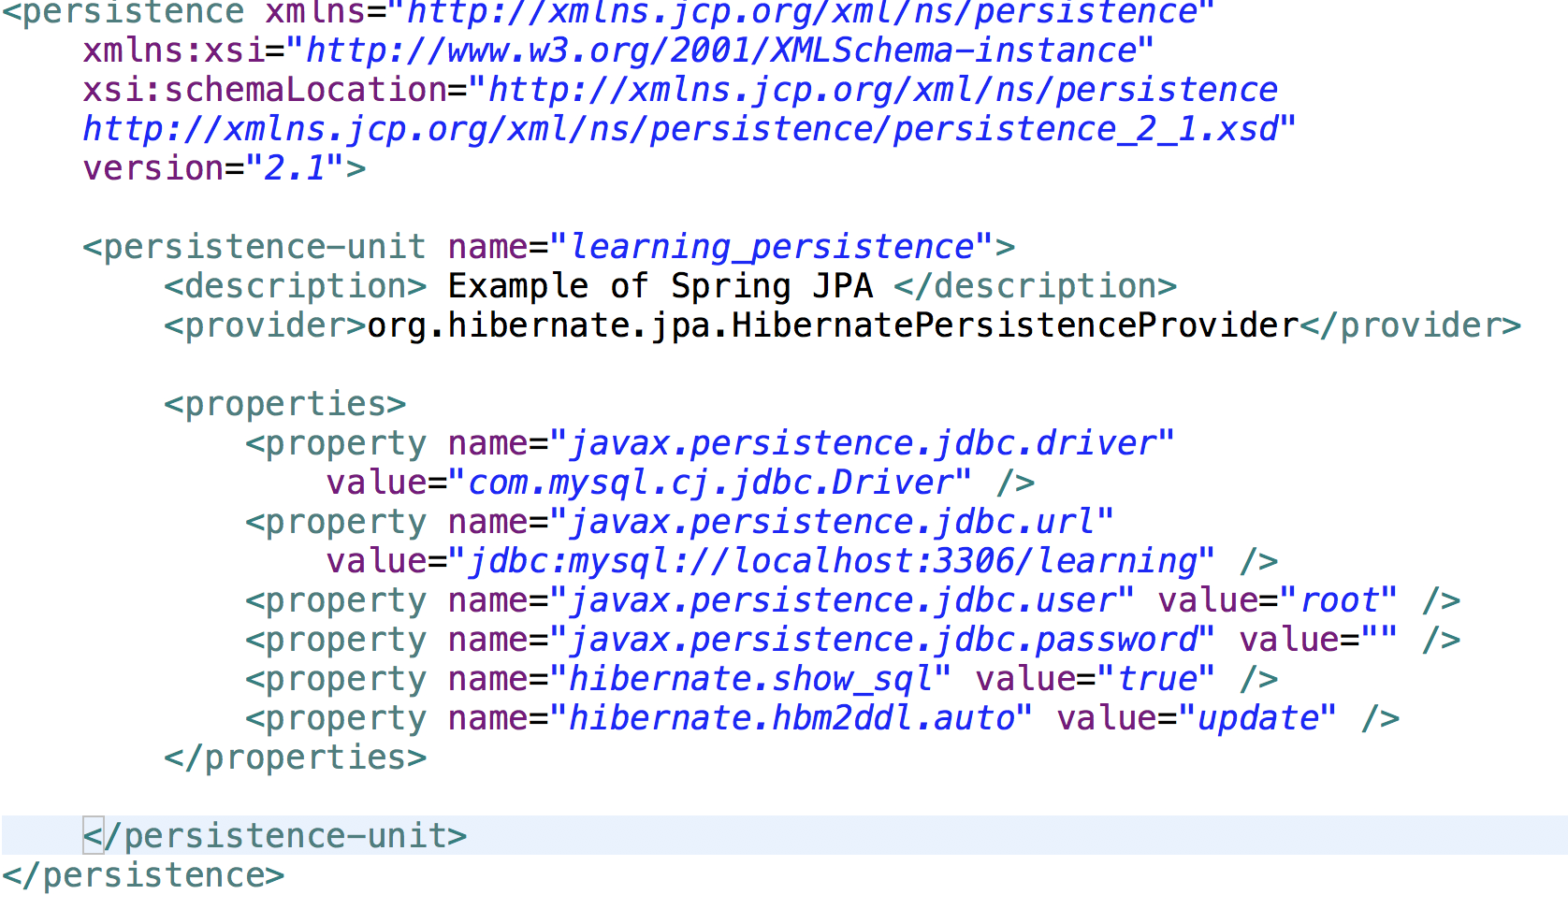
META-INF\persistence.xml

Slide 7
Beans for EntityManager and Tx Manager
Have to Create 2 beans
LocalEntityManagerFactoryBean
JpaTransactionManager

Slide 8
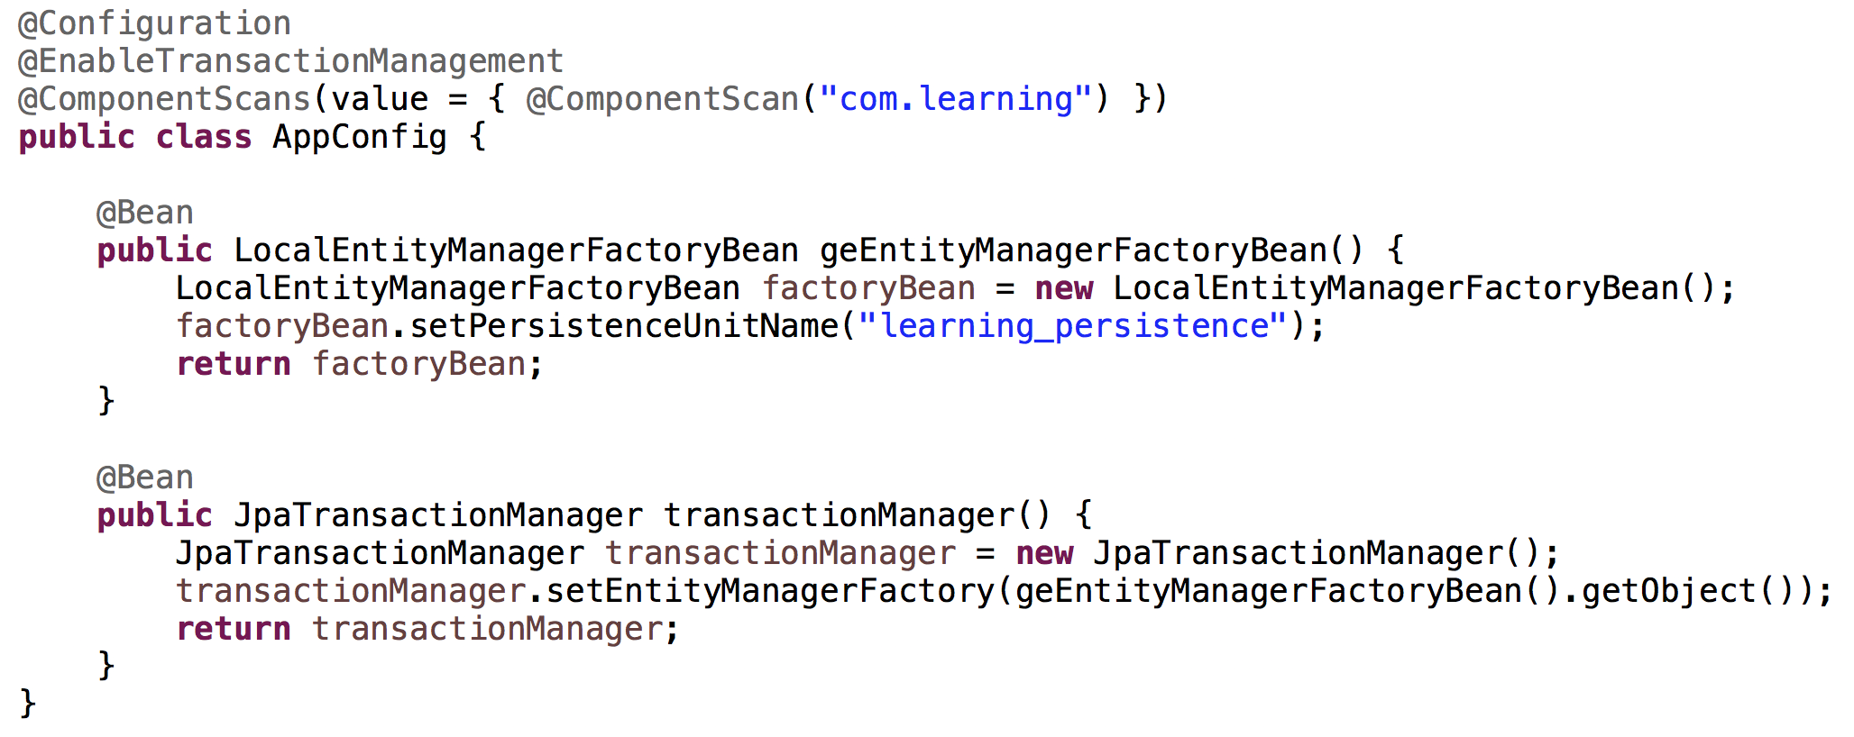
Beans for EntityManager and Tx Manager

Slide 9
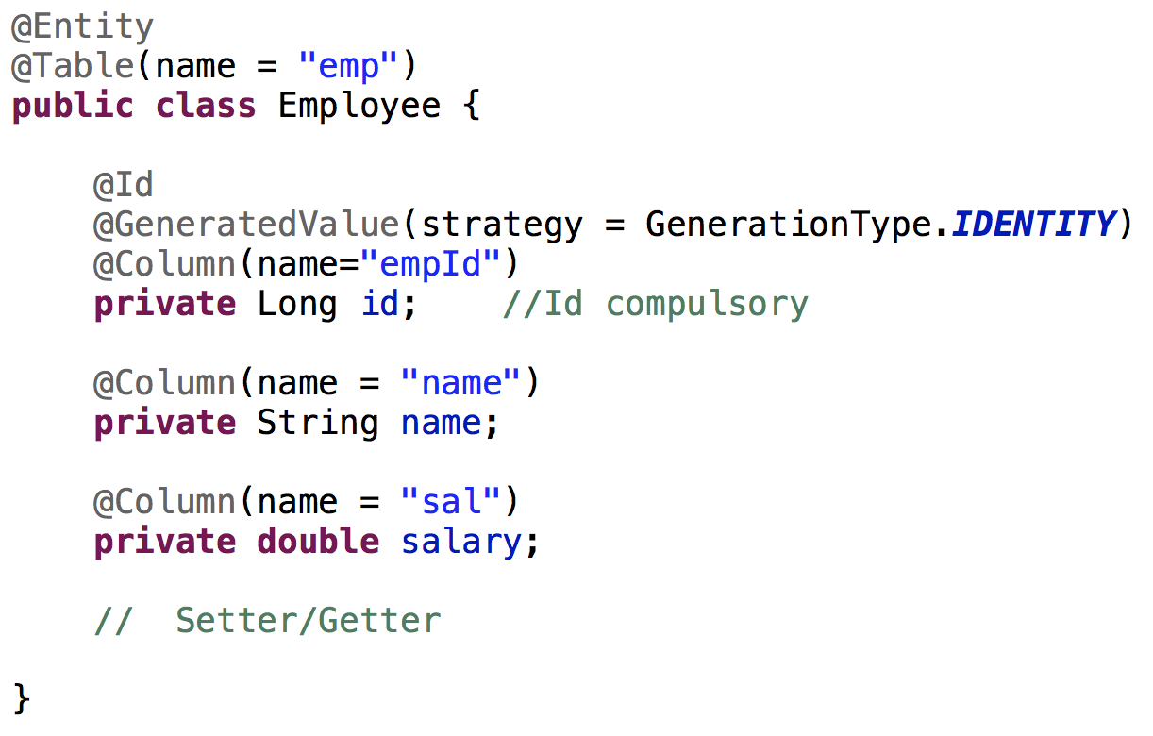
Writing Entity Class

Slide 10
Dao
For class, you need to use the annotation
@Repository
Entity Manager will interact with persistence context @PersistenceContext private EntityManager em;
Some useful methods
persist
remove
find
createQuery
createNamedQuery

Slide 11
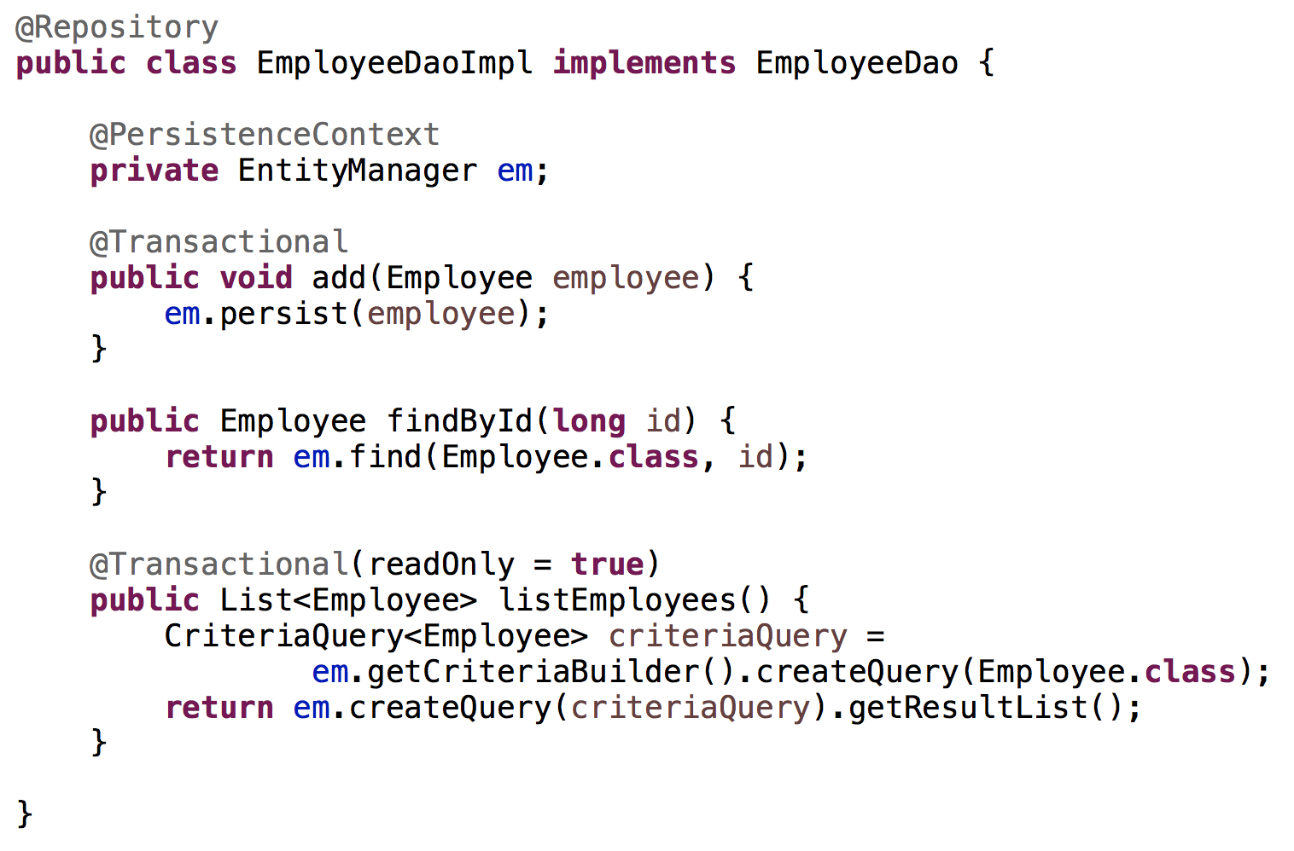
Dao

Slide 12
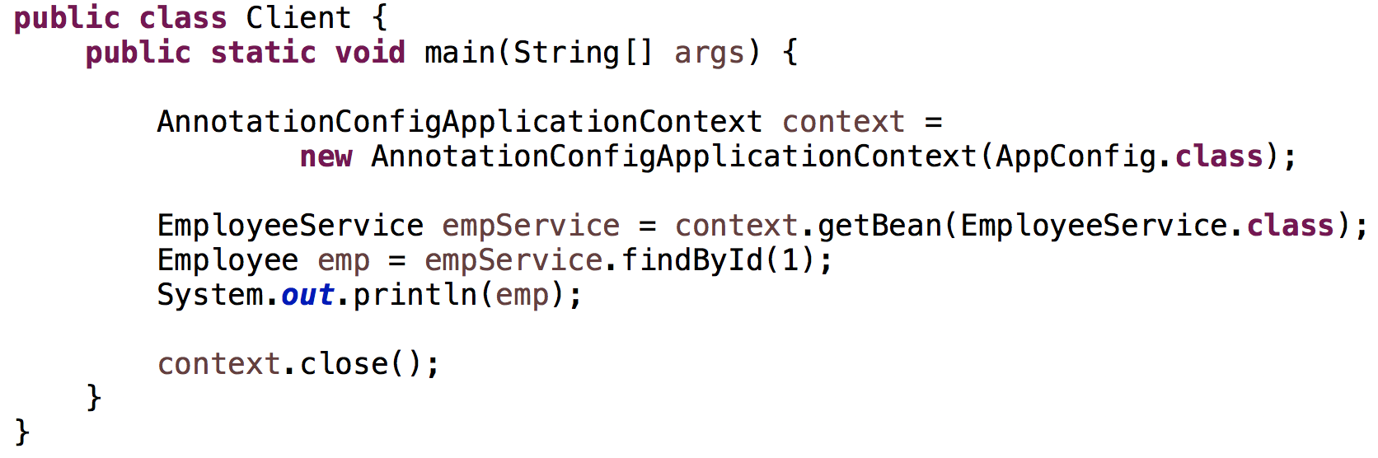
Client

